Slide 1
Context-Free Languages
Definition:
Context-free languages (CFLs) are generated by context-free grammars.The set of all context-free languages is identical to the set of languages accepted by pushdown automata, and the set of regular languages is a subset of context-free languages. An inputed language is accepted by a computational model if it runs through the model and ends in an accepting final state. All regular languages are context-free languages, but not all context-free languages are regular. Most arithmetic expressions are generated by context-free grammars, and are therefore, context-free languages. Context-free languages and context-free grammars have applications in computer science and linguistics such as natural language processing and computer language design.

Slide 2
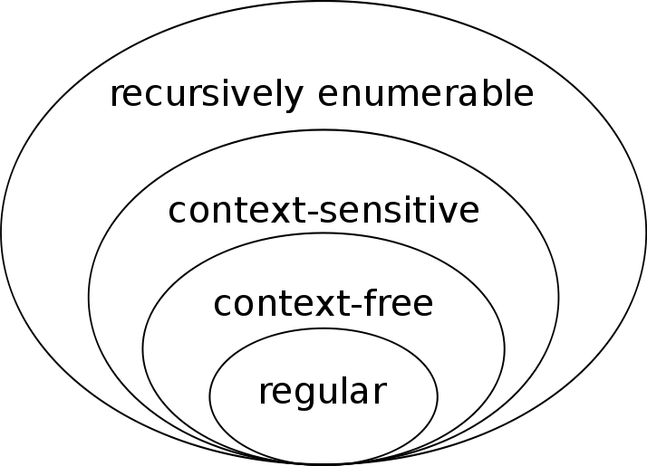

Slide 3
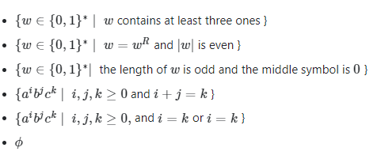
Examples:

Slide 5
How to convert a CFL from a CFG?
G = ({S}, {0, 1}, P, S) // Remember: G = (V, T, P, S)
P:
(1) S –> 0S1 or just simply S –> 0S1 | ε
(2) S –> ε
Example Derivations:
S => 0S1 (1) S => ε (2)
=> 01 (2)
S => 0S1 (1)
=> 00S11 (1)
=> 000S111 (1)
=> 000111 (2)
Note that G “generates” the language {0^{k}1^{k} | k≥0}

Slide 6
How to convert a CFL from a CFG?
G = ({A, B, C, S}, {a, b, c}, P, S)
P:
(1) S –> ABC
(2) A –> aA A –> aA | ε
(3) A –> ε
(4) B –> bB B –> bB | ε
(5) B –> ε
(6) C –> cC C –> cC | ε
(7) C –> ε
Example Derivations:
S => ABC (1) S => ABC (1)
=> BC (3) => aABC (2)
=> C (5) => aaABC (2)
=> ε (7) => aaBC (3)
=> aabBC (4)
=> aabC (5)
=> aabcC (6)
=> aabc (7)
Note that G generates the language a*b*c*

Slide 7
Properties:
In formal language theory, a language is defined as a set of strings of symbols that may be constrained by specific rules.
Similarly, the written English language is made up of groups of letters (words) separated by spaces.
A valid (accepted) sentence in the language must follow particular rules, the grammar.
A context-free language is a language generated by a context-free grammar.
They are more general (and include) regular languages.
The same context-free language might be generated by multiple context-free grammars.
The family of regular language is a proper subset of the family of context free language.
Each Context Free Language is accepted by a Pushdown automaton.
The set of all context-free languages is identical to the set of languages that are accepted by pushdown automata (PDA).

Slide 8
Properties:
The context free languages are closed under union.
The context free languages are closed under concatenation.
The context free languages are closed under kleen closure.
The context free languages are not closed under intersection and complement.

Slide 9
Closure Properties
A set is closed under an operation if doing the operation on a given set always produces a member of the same set. This means that if one of these closed operations is applied to a context-free language the result will also be a context-free language.

Slide 10
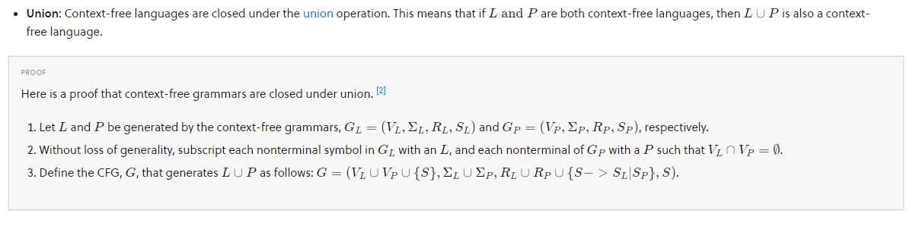
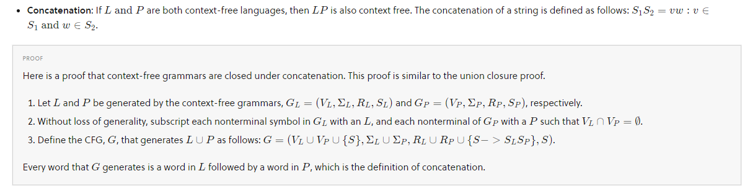
Closure Properties

Slide 11
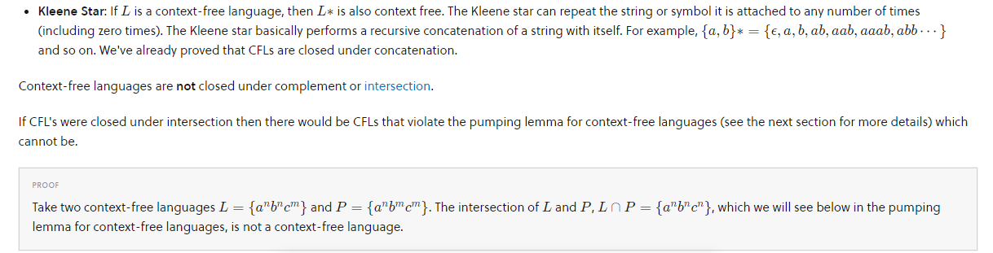
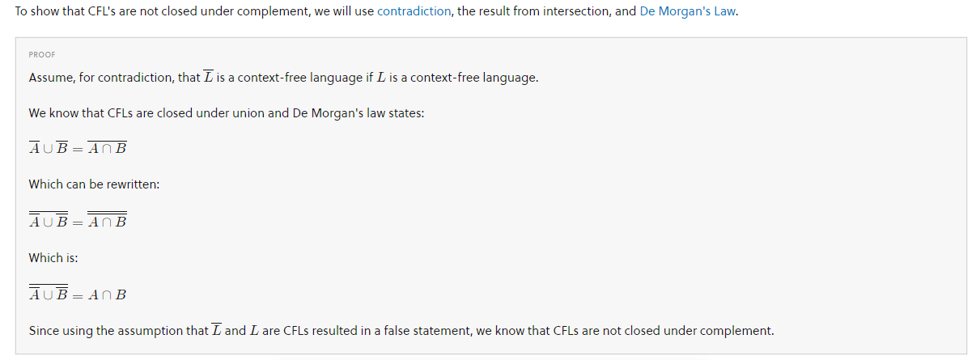

Slide 12
Pumping Lemma for Context-Free Languages
Proving that something is not a context-free language requires either finding a context-free grammar to describe the language or using another proof technique (though the pumping lemma is the most commonly used one). A common lemma to use to prove that a language is not context-free is the Pumping Lemma for Context-Free Languages.
All context-free languages are “pumpable” meaning that the pumping lemma constraints hold true for all context-free languages. If a language is not pumpable, then it is not a context-free language. However, if a language is pumpable, it is not necessarily a context-free language. Because the set of regular languages is contained in the set of context-free languages, all regular languages must be pumpable too.

Slide 13
Essentially, the pumping lemma holds that arbitrarily long strings s ∈ L can be pumped without ever producing a new string that is not in the language L.
Basically, the idea behind the pumping lemma for context-free languages is that there are certain constraints a language must adhere to in order to be a context-free language. You can use the pumping lemma to test if all of these constraints hold for a particular language, and if they do not, you can prove with contradiction that the language is not context-free.

Slide 14
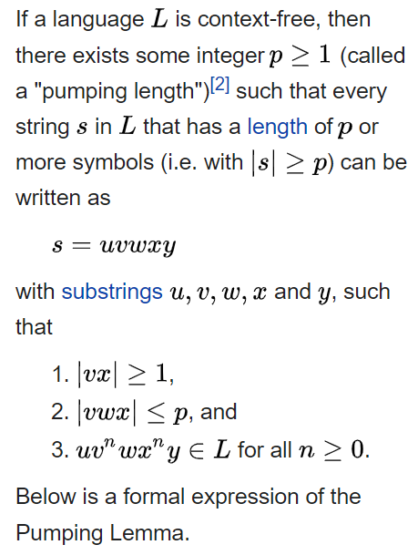
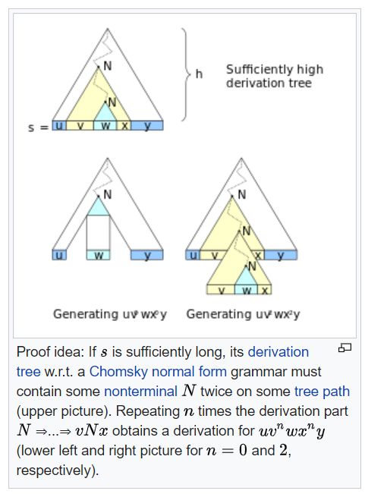

Slide 15
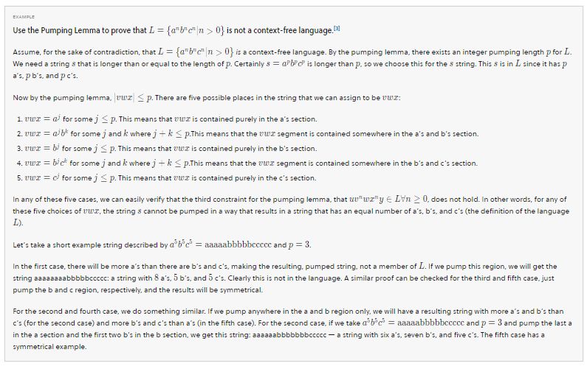

Slide 16
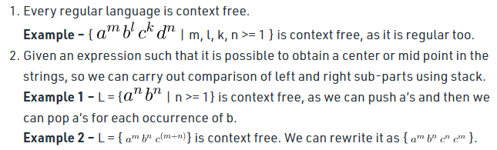

Check if the language is Context Free or Not

Slide 17
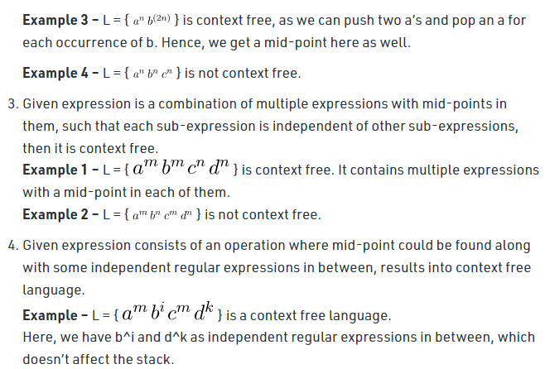

Slide 18
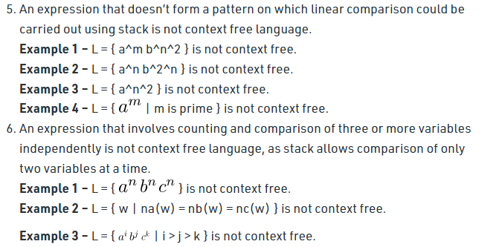

Slide 19
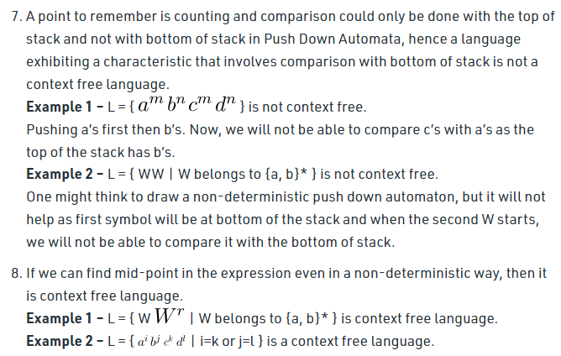

Slide 20
Deterministic context-free language
In formal language theory, deterministic context-free languages (DCFL) are a proper subset of context-free languages. They are the context-free languages that can be accepted by a deterministic pushdown automaton. DCFLs are always unambiguous, meaning that they admit an unambiguous grammar. There are non-deterministic unambiguous CFLs, so DCFLs form a proper subset of unambiguous CFLs.
Deterministic context-free languages can be recognized by a deterministic Turing machine.

Slide 21
Properties of deterministic context-free language
The set of deterministic context-free languages is closed under the following operations:
complement
inverse homomorphism
right quotient with a regular language
pre: pre(L) is the subset of all strings having a proper prefix that also belongs to L.
min: min(L) is the subset of all strings that do not have a proper prefix in L.
max: max(L) is the subset of all strings that are not the prefix of a longer string in L.
The set of deterministic context-free language is not closed under the following operations:
union
intersection
concatenation
Kleene star
ε-free morphism
Mirror image

Slide 22
Home Work
Show that L = {0n1n| n ≥ 0} is deterministic context-free language.
Show that L = {wwR∣w∈{a,b}∗} is non-deterministic context-free language.
Show that L={a^n b^n |n≥1}is CFL.
Show that L={a^p |p is prime}is not CFL.

Slide 23
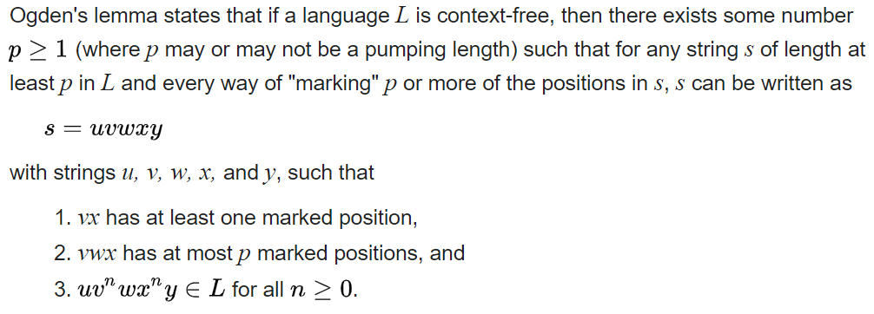
Ogden's Lemma
In the theory of formal languages, Ogden's lemma (named after William F. Ogden) is a generalization of the pumping lemma for context-free languages.
Statement

Slide 24
Theorem: Let L be a regular language. Then L is a context-free language. (or, RL ⊆CFL)
Proof: (by induction)
We will prove that if r is a regular expression then there exists a CFG G such that L(r) = L(G). The proof will be by induction on the number of operators in r.
Basis: Op(r) = 0
Then r is either Ø, ε, or a, for some symbol a in Σ.
For Ø:
Let G = ({S}, {}, P, S) where P = {}
For ε:
Let G = ({S}, {}, P, S) where P = {S –> ε}
For a:
Let G = ({S}, {a}, P, S) where P = {S –> a}

Slide 25
Inductive Hypothesis:
Suppose that for any regular expression r, where 0≤op(r) ≤ k, that there exists a CFG G such that L(r) = L(G), for some k>=0.
Inductive Step:
Let r be a regular expression with op(r)=k+1. Then r = r₁ + r₂, r = r₁r₂ or r = r₁*.
Case 1) r = r₁ + r₂
Since r has k+1 operators, one of which is +, it follows that r₁ and r₂ have at most k operators. From the inductive hypothesis it follows that there exist CFGs G₁ = (V₁, T₁, P₁, S₁) and G₂ = (V₂, T₂, P₂, S₂) such that L(r₁) = L(G₁) and L(r₂) = L(G₂). Assume without loss of generality that V₁ and V₂ have no non-terminals in common, and construct a grammar G = (V, T, P, S) where:
V = V₁ ∪ V₂ ∪ {S}
T = T₁ ∪ T₂
P = P₁ ∪ P₂ ∪ {S –> S₁, S –> S₂}
Clearly, L(r) = L(G).

Slide 26
Definition: Let G be a CFG. Then G is said to be ambiguous if there exists an x in L(G) with >1 leftmost derivations. Equivalently, G is said to be ambiguous if there exists an x in L(G) with >1 parse trees, or >1 rightmost derivations.
Note: Given a CFL L, there may be more than one CFG G with L = L(G). Some ambiguous and some not.
Definition: Let L be a CFL. If every CFG G with L = L(G) is ambiguous, then L is inherently ambiguous.

Slide 27
An ambiguous Grammar:
E -> I ∑ ={0,…,9, +, *, (, )}
E -> E + E
E -> E * E
E -> (E)
I -> ε | 0 | 1 | … | 9
A string: 3*2+5
Two parse trees:
* on top, & + on top
& two left-most derivation:
A leftmost derivation
E=>E*E
=>I*E
=>3*E+E
=>3*I+E
=>3*2+E
=>3*2+I
=>3*2+5
Another leftmost derivation
E=>E+E
=>E*E+E
=>I*E+E
=>3*E+E
=>3*I+E
=>3*2+I
=>3*2+5

Slide 28
E -> I ∑ ={0,…,9, +, *, (, )}
E -> E + E
E -> E * E
E -> (E)
I -> ε | 0 | 1 | … | 9
E=>E*E
=>I*E
=>3*E+E
=>3*I+E
=>3*2+E
=>3*2+I
=>3*2+5
E
E
*
E
I
E
+
E
E
3
I
I
Another leftmost derivation
E=>E+E
=>E*E+E
=>I*E+E
=>3*E+E
=>3*I+E
=>3*2+I
=>3*2+5
E
+
E
2
5
I
E
*
E
5
I
I
3
2

Slide 29
Ambiguous grammar:
E -> I
E -> E + E
E -> E * E
E -> (E)
I -> ε | 0 | 1 | … | 9
Disambiguation of the Grammar:
∑ ={0,,,9, +, *, (, )}
E -> T | E + T // This T is a non-terminal, do not confuse with ∑
T -> F | T * F
F -> I | (E)
I -> ε | 0 | 1 | … | 9
A string: 3*2+5
Only one parse tree & one left-most derivation now:
+ on top: TRY PARSING THE EXPRESSION NOW

Slide 30
A language may be Inherently ambiguous:
L ={a^{n}b^{n}c^{m}d^{m} | n≥1, m ≥ 1} ∪ {a^{n}b^{m}c^{m}d^{n} | n ≥ 1, m ≥ 1}
An ambiguous grammar:
S -> AB | C
A -> aAb | ab
B -> cBd | cd
C -> aCd | aDd
D -> bDc | bc
Try the string: aabbccdd, two different derivation trees
Grammar CANNOT be disambiguated for this (not showing the proof)

Slide 31
String aabbccdd belongs to two different parts of the language:
L ={a^{n}b^{n}c^{m}d^{m} | n≥1, m ≥ 1} ∪ {a^{n}b^{m}c^{m}d^{n} | n ≥ 1, m ≥ 1}
Rules:
S -> AB | C
A -> aAb | ab
B -> cBd | cd
C -> aCd | aDd
D -> bDc | bc
Derivation 1 of aabbccdd:
S => AB
=> aAbB
=> aabbB
=> aabb cBd
=> aabbccdd
Derivation 2 of aabbccdd:
S => C
=> aCd
=> aaDdd
=> aa bDc dd
=> aabbccdd

